Slide 1
IoT Based Smart Bottle
Under guidance of
Dr Goldvin Sugirtha Dhas B,
Assistant Professor(EEE),
BIT,
Sathy.
Priya Dharshini R - 201BM127
Kamalesh J – 201EC171
Kanishma G - 201EC174

Slide 2
Abstract
Patient fed with saline or glucose requires the healthcare staff and caretaker to monitor the flow rate of saline, adjust the flow rate on certain conditions, stop the flow, and unplug the needle from the patient which is sometimes become difficult as the healthcare staff needs to monitor other patients or may feel sleepy at night. This paper proposes an IoT-based flow rate monitoring system to assist the healthcare staff. The system consists of level measurement and a microcontroller to give prediction and alert. A clamp is introduced in the bottle such that, when the nurse fails to attend to the patient, the clamps would clamp the saline bottle without any further delay. Hence, fatal accidents can be prevented. The miniature module of the system was developed and found effective. It can be utilized in the hospitals for assisting the healthcare staff.

Slide 3
Problem Statement Addressed
Hospital uses simple electrolytes bottles with no indication, it may create a problem to patient because the reverse flow will start, blood start to flow from body towards bottle. In, Hospital ICU, CCU, NICU, OPD, OT, most of all department of hospital required such kind of automatic monitoring and indication system. Also Healthcare industries will one of the users. such monitoring system can be useful in small , medium and large size of hospitals and also it useful during home care.

Slide 4
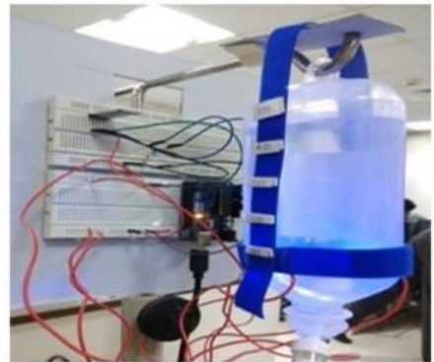
Existing Solution to the Problem Addressed
There isn’t any complete and fully functional product available in market, though we find some of working prototype for the above addressed problem.
i) This prototype uses the method of optical sensing mechanism, the amount of transmitted light from the LED to the photodiode depends upon the electrolyte in the saline bottle. The voltage across the photodiode is monitored every millisecond. When the saline water reaches predefined percentage of the bottle capacity, the alarm is being produced.

Slide 5
Proposed Solution to the Problem Addressed
The proposed system eliminates continuous visual monitoring of the patient by nurses from distinct places.The saline bottle needs to changed once the saline reaches the critical level. In this system, we use various components like ultrasonic sensor for determining the status of the saline level whether it has reached the normal level(10cm) or critical level(14cm) if saline bottle is 15 cm in length.
By using Wi-Fi module of nodeMCU and Blynk application which receives and sends data through mobile. The change in threshold level activates the alarm at the nurse station at the critical level mark. However,when the nurse fails to attend the particular patient, the saline bottle is clamped automatically to avoid further consequences.
The above program is monitored using AurduinoIDE software and uploaded to ATmega328P, NodeMCU ESP-8266 using the same software.

Slide 6
Project Work Plan
1) Level sensor(Ultrasonic Sensor) will continuously check the level of saline liquid present in bottle whether it is above or below the critical level.
2) If level of saline liquid is at or below critical point, alarm will be generated.
3) Immediately notification will be sent to the nurse that the saline is below critical level and there is a need for replacement of saline bottle.
4) Prediction of the saline bottle required based on the various parameters or health condition is given to the doctors.
5) If in case, concerned patient is not acknowledged by the nurse, automatically the reverse flow of the blood into the saline bottle will be prevented.

Slide 7
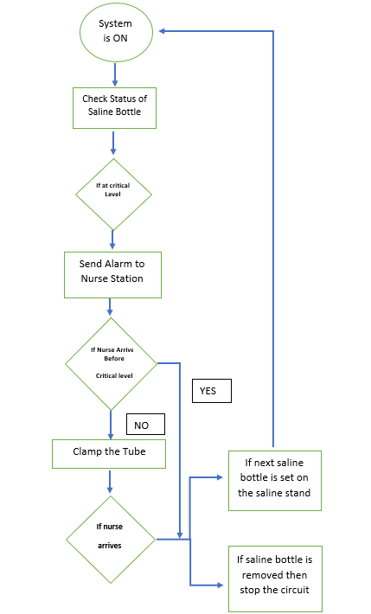
­­­Flow Chart
­­­

Slide 8
Block Diagram and/or Circuit Diagram
IOT SYSTEM
ANDROID BASED SMART PHONE
ULTRASONIC SENSOR
MICRO CONTROLLER
SALINE BOTTLE
ALERTING SYSTEM
CLAMP SYSTEM

Slide 9
Effective utilization of the Modern Tool & Cloud
Arduino IDE: Arduino Integrated Development Environment (IDE) is a software platform used to write code for microcontroller boards like Arduino or node MCU which has libraries for particular applications, a serial monitor to show output on a computer screen.
Blynk: Blynk is an application used for IoT applications, which controls IoT-enabled devices remotely. It collects data from the sensor store it in the blynk cloud & gives access to the user to control the device remotely.

Slide 10
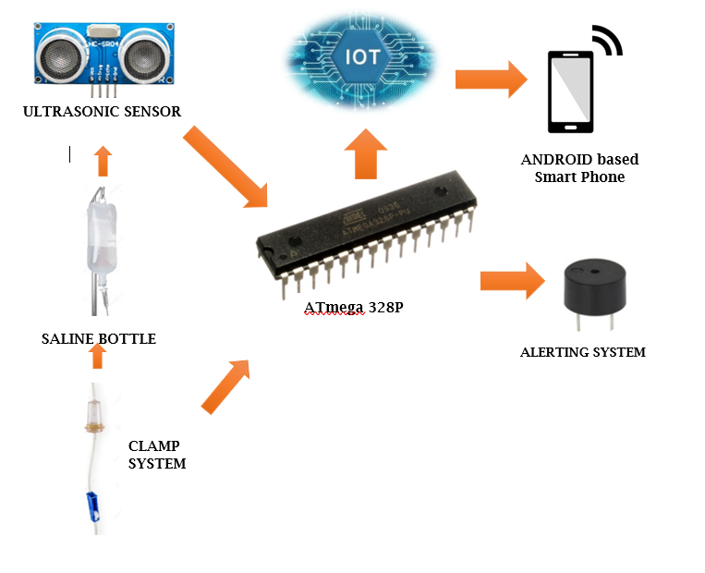
Technology stack:

Slide 11
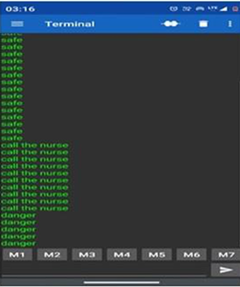
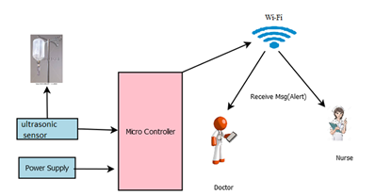
Prototype & Sample Output

Slide 12
Analysis of Results & Discussions
In this paper we are developing efficient and high performance automatic saline level monitoring system. By using this system, we are able to make all processes automated which reduces waiting time for doctors ,staff and nurse. This system will help nurse and staff to improve their work speed and performance all information will be digitized .

Slide 13
Cost Benefit Analysis (List of Components / Service Used)
S.No | Component Name | Specification (IC number or Range or Value) | Unit Cost(Rs) | Total Cost
1. | Ultrasonic Sensor | 2cm-400cm | 59 | 59
2. | ATmega328P | 328P | 699 | 699
3. | NodeMCU ESP8266 |  | 205 | 205
4. | Buzzer | 31 Hz to 65535 Hz | 20 | 20

Slide 14
References
S.Gupta, M.Kulkarni, and Y.Kulkarni, Smart Saline Monitoring System Using Load Cell and RF Sensor, International Research Journal of Engineering and Technology (IRJET), 05 (06)|,2018.
Priyadharshini. R, Mithuna. S, VasanthKumar. U, Kalpana Devi. S, Dr. Suthanthira Vanitha. N. "Automatic Intravenous Fluid Level Indication System for Hospitals" International Journal for Research in Applied Science & Engineering Technology ; Volume 3 Issue VIII, August 2015."
C.C. Gavimath , Krishnamurthy Bhat , C.L. Chayalakshmi , R. S. Hooli and B. E. Ravishankera "Design And Development Of Versatile Saline Flow Rate Measuring System " International Journal of Pharmaceutical Applications Vol 3, Issue 1, 2012."

